Slide 1

College
Preparatory
Middle
School
“A Nurturing Community for the Middle School Learner.”
Christina M. Callaway, M.A., PPS
Mitchell S. Miller, M.A., Ed.S., PPS

Slide 2
Presentation outcomes
Who are We?
What is a Charter School?
What is Offered at CPMS?
How to Enroll?

Slide 3
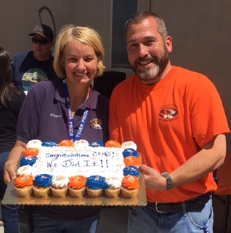
Co-Founders/administrators
CPMS Co-Directors
Christina M. Callaway & Mitchell S. Miller

Slide 4
What is a Charter School?
Charter Schools…
Open to the Public;
Publicly Funded;
Tuition-Free;
Must Comply with Both State and Federal Educational Mandates;
Participate in State Testing;
Employ Credentialed Teachers.

Slide 5
CPMS Charter
State Board of Ed (SBE) Approved
  March 2018
  Authorizer/Oversight
Serving Grades 5-8
Direct Funded Charter
LEA
  Curriculum
  Employment

Slide 6
10269 Madrid Way, Spring Valley, CA 91977

Slide 7
CPMS: New Modern Facility
New Facility (10269 Madrid Way)
Occupancy began September 2019
Modern, Safe, Designed Specifically for Middle School Use
  State of the Art Facility
  Expansive Program Offerings
  Spacious Classrooms (conducive to learning)
  Advanced Technological Infrastructure
  Turf Playing Field
  Safe and Secure Campus
2025-26 School Year: Continued Facility Enhancements

Slide 11
history of strong Academic Achievement
California Assessment of Student Performance and Progress
(CAASPP - 2024)
 | State | County | District | CPMS
ELA | 47.0% | 52.2% | 46.5% | 85.3%
Math | 35.5% | 40.5% | 36.8% | 76.3%
Science | 30.7% | 35.5% | 32.5% | 72.2%
% - Met or Exceeded State Standards

Slide 12
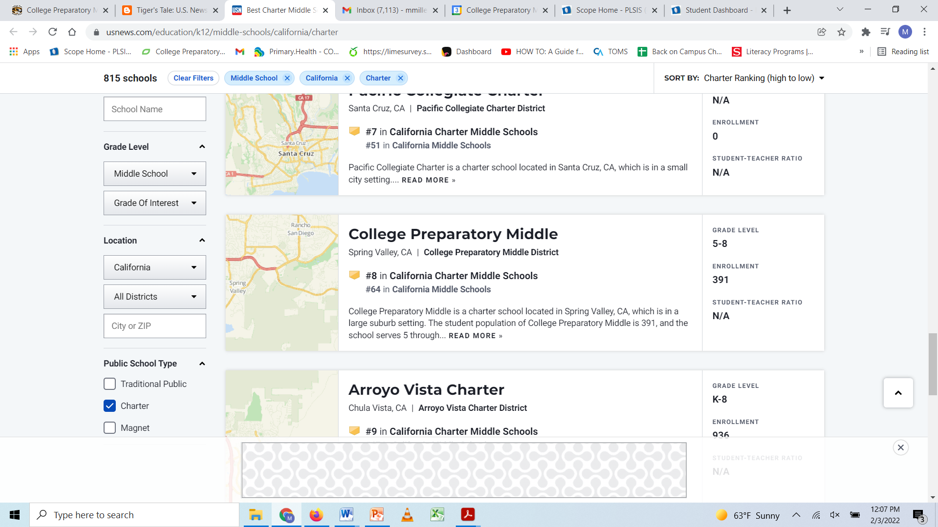
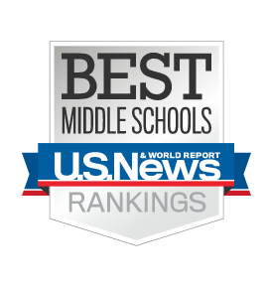
history of strong Academic Achievement
U.S. News and World Report
College Prep #8 Best Charter Middle School in California
(#64 Middle School in the State)

Slide 13

history of strong Academic Achievement
California State AND National
Schools To Watch
(2023)

Slide 14
What We Offer at CPMS:
An Academically Demanding Program with a Strong Literacy Base.
  Yes, we do assign a fair amount of homework.
A Positive College-Bound Focus
Small Class Size
  25 students per Class
Differentiated Instruction
Data-Driven Decision Making
Technologically Integrated Learning
  Google Classroom Learning Management System
  Online Curriculum/Platforms
2:1 Chromebooks

Slide 15

What We Offer at CPMS:
Full Compliment of Core Subject Matter
  California State Standards
  Technologically Advanced Curriculum
  Focus on Foundational Skills
  Enrichment
  Supports for Student Success
  Grade Level Electives
Preparation for High School-Level Coursework
  Study Skills/Organization Skills
  Articulation with Local High Schools

Slide 16

What We Offer at CPMS:
College Prep maintains
HIGH EXPECTATIONS
for
ALL STUDENTS.
The rigorous college preparatory curriculum is challenging and students should come
PREPARED to WORK HARD & SUCCEED!

Slide 17
What We Offer at CPMS:
A Single School Culture Organized for Learning.
  Tiger Pride!!!
  CPMS Dress Code
Development of Good Character and Positive Citizenship for the 21st century.
  BULLIES BEWARE!!!
Home – School Partnership.
  Collaboration with Community Organizations.

Slide 18

What We Offer at CPMS:
Positive Behavior Supports
  Recognize, Reward, Reinforce
  PREP Tickets/Drawings
    Prepared
    Respectful
    Engaged
    Professional
  College Bound Celebrations
Tigers Den (Homeroom: Character/Skill Building)
Student Government Association (SGA)
Parent-Teacher-Student-Association (PTSA)
English Language Advisory Council (ELAC)

Slide 19

What We Offer at CPMS:
Traditional School Calendar
55-minute Bell Schedule (Gr 6-8)
Block Schedule (Gr 5)
Quarter System
Lunch Service
After-School Tutorial (optional)
After-School Activities

Slide 20

College Prep in Middle School???
You may be wondering:
  “Is middle school too early to start preparing
  for high school and beyond???”

Slide 21
California college admissions (2025)
At just shy of 300,000 graduate and undergraduate students across its 10 campuses, the University of California enrolled the biggest and most diverse student body in its history for fall 2024.
UC San Diego received a record 160,150 applications from prospective students seeking to enroll this fall as freshmen or transfers, the second-highest figure among the nine undergrad campuses in the University of California system. Only UCLA attracted more interest, drawing 173,297 fall applications.
Among undergraduates, there were significant gains for in-state students, transfers and students from underrepresented groups, highlighting years of partnership between UC and the state to increase opportunity for Californians. In all, UC undergraduate enrollment rose by 1.2 percent to land at 236,070.
To enroll in a UC for Fall 2025, applicants must complete 15 "a-g" college preparatory courses with a minimum GPA of 3.0 (California residents) or 3.4 (non-residents), with no grade lower than a C, and meet subject requirements in areas like English, math, science, history, and a second language.
The California Community Colleges (CCC) projects that 1.48 million students will enroll in the fall of 2024–2025. The CCC is the largest postsecondary education system in the United States.

Slide 22
Enrollment For 2025 - 2026
Online Intent to Enroll Application
  www.MyCPMS.net
  “Enrollment” Tab
  DUE March 17th by 3:00 pm (No Exceptions)
Lottery
  Completed Applications> Available Spaces
  Friday, March 21st, 2025 at 3:00 p.m.
  Determines Enrollment/Waitlist
  Applications submitted after the lottery window will be placed on the Waitlist (per grade) based upon submission date/time.
  Families will be notified as space becomes available.

Slide 23



Slide 24


Enrollment For 2025 - 2026
www.MyCPMS.net
All Things CPMS, All The Time
Enrollment Info/Dress Code Info
School Calendar/Bell Schedule
Teacher Directory
Student Handbook
Parent Portal
ParentSquare
PTSA/SGA/ELAC/SELPA Info
Student Resources

Slide 25
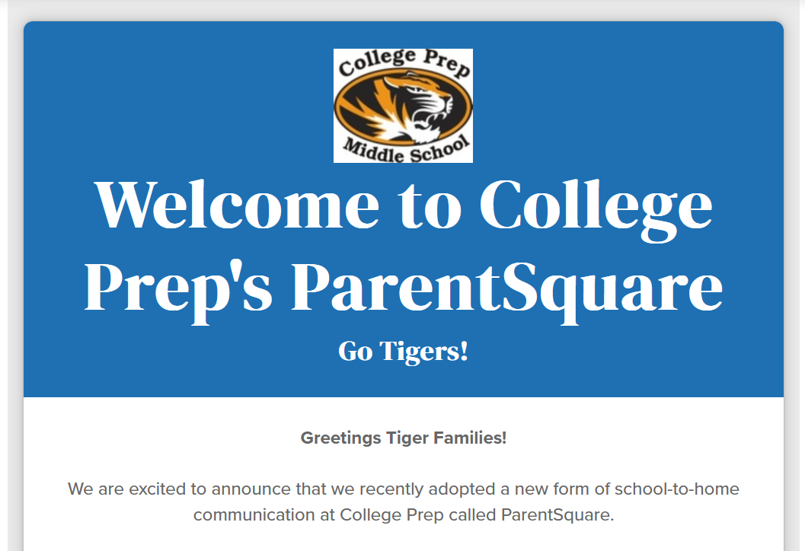

Slide 26

Enrollment For 2025 - 2026
☺ First Day of School ☺
Tuesday, September 2nd, 2025
8:00 a.m. – 2:35 p.m.
Literacy Rocks!!!

Slide 27

Get Ready to Earn Your Stripes!

